Slide 1
USAID Program for Advancing Supply Chain Outcomes
(PASCO)
Bidders’ Conference for the
Last Mile Third Party Logistics (3PL) - Distribution of Health Commodities – ZAMMSA Luanshya Hub
October 22, 2024

Slide 2

Agenda
Welcoming remarks/project overview
Geographical Scope of Work
What do we have to offer
Introduction of the RFP
Important dates to remember
Overview (Procurement Guidelines)
Proposal submission
General requirements
Subcontract type
Pricing
Annex 3 – Historical information
Technical Evaluation
KPIs
Vehicle Inspection Checklist
Purchase Order Process
Questions

Slide 3
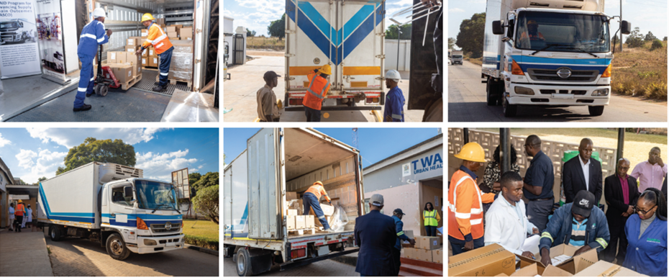
Welcoming Remarks/Project Overview
USAID-funded project
27 staff in Zambia
In Lusaka and ZAMMSA Hubs across 5 provinces
5-year project (November 2022 to November 2027)
In collaboration with the Zambia Medicines and Medical Supplies Agency (ZAMMSA) and the Zambian Ministry of Health (MOH), USAID PASCO is a commodity distribution project that works to create sustainable access to health commodities at the last mile by enhancing the use of private sector, third-party logistics (3PL) providers in Zambia’s national health supply chain.
A 3PL truck completes the distribution cycle from Luanshya Hub to Twapia Urban Health Center in Ndola.

Slide 4
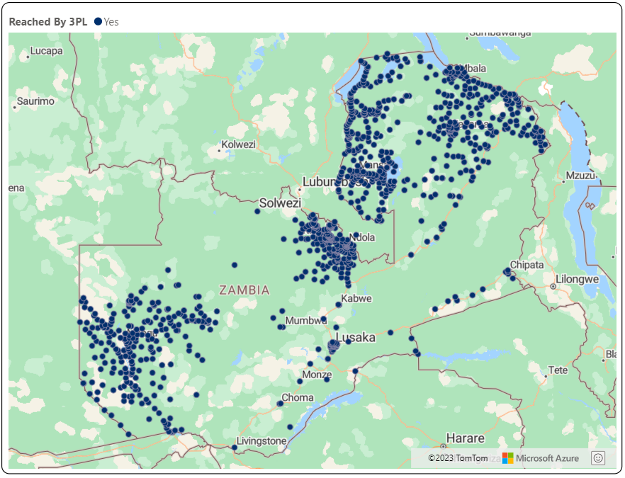
Scope of 3PL last-mile distribution services
Geographic coverage
USAID PASCO provides supplemental 3PL support in all ten provinces.
USAID PASCO supports ZAMMSA Hubs with last-mile operations in the Copperbelt, Luapula, Muchinga, Northern, and Western provinces.
USAID PASCO's support to Lusaka and Central Province is focused on bulk distribution from ZAMMSA Central to DHOs and high-volume sites.
USAID PASCO's support to the Southern, Eastern, and North-Western regions is focused on bulk deliveries from Lusaka to hubs, DHOs, and high-volume sites.
Mansa Hub
Mpika Hub
Luanshya Hub
Kabompo Hub
Mongu Hub
Chipata Hub
ZAMMSA Central
Choma Hub

Slide 5
What do we have to offer transportation firms as USAID PASCO Project?
The opportunity for a steady stream of business from points of origin in Lusaka, Luanshya, Mansa, Mpika, and Mongu.
Long-term business continuity – with clearly outlined framework subcontracts of 1-2 years with clear pricing terms.
Payment terms that are commensurate with the commercial sector.
Business expansion and brand recognition in a public-private forum.

Slide 6
Introduction of the RFP
The USAID PASCO is soliciting offers from companies to submit proposals for the provision of last-mile distribution services at ZAMMSA’s Hub in Luanshya, Copperbelt province.
Successful offerors will be required to ensure a minimum of 15% of order lines are serviced using directly-owned fleet during implementation with Chemonics reserving the right to request up to 50% of order lines to serviced, with directly owned fleet in the event of performance issues.
The awardees will be responsible for ensuring a full-time logistics person is based at the hub to coordinate the distribution operations.
The time-period for the delivery of distribution services under resulting IQSs will last for one year, from approximately December 9, 2024, to December 8, 2025, with an optional one-year extension period.

Slide 7
Important Dates To Remember

Slide 8
Overview- Procurement guidelines (3PL)
USAID PASCO’s procurement guidelines and procedures utilized are;
    Transparent,
    Well-documented, and
    In compliance with USAID regulations and Chemonics’ Standards of Business Conduct.

Slide 9
Overview- Procurement Methodology
Established an evaluation methodology that is clear and transparent;
    Administrative review
    Compliance with RFP requirements
    Technical evaluation (pages 16-19)
    In-depth interrogation (including fleet evaluation)
    Cost evaluation
    Determination of price reasonability
    Obtain clarifications from offerors, as needed and applicable
    Select the best value for award based on the evaluation criteria in the solicitation

Slide 10
Proposal Submission
    Technical proposal and Cost proposal with all relevant support documentation must be submitted separately electronically and clearly labeled as such
    Technical proposal MUST NOT have ANY costing data/information in it.
    The prescribed deadline of 17:00hrs on November 03, 2024, must be adhered to unless advised otherwise through an amended RFP

Slide 11
General Requirements
    Please refer to page 7-8 Section 1.4A and 1.4B of the RFP for minimum general requirements
        - Full names of members of the Board of Directors and Legal Representative.
        - Taxpayer Identification Number.
        - UEI Number.
        - Official bank account information.
        - Recent financial statements for at least past six month that verify that the organization has sufficient operating capital to undertake the work outlined in its Offer.
    Disclaimer: It is the offerors’ responsibility to ensure that all regulations, legal and any other statutory requirements that govern the transportation and distribution of public health commodities in Zambia are adhered.

Slide 12
Subcontract Type
    Indefinite Quantity Subcontract (IQS)
    Subcontract Ceiling is ZMW 3,023,000 with a maximum order < ZMW 3,023,000.
Zone# | Origin/Point Dispatch | Total Estimated Maximum Value
1 | ZAMMSA Luanshya Hub | ZMW 3,023,000.00

Slide 13
Pricing
With reference to annex 2, the pricing for this RFP and any resulting award will be divided into two types:
  Type 1: Routes/facilities that are generally accessible and can be reached using conventional vehicles (a 4x4 SUV at a minimum). Per km pricing shall apply based on vehicle type.
  Type 2: Routes/facilities that require specialized equipment and/or any combination of unconventional forms of transportation (i.e. fully kitted SUV with winch and accessories, water-based transport, motorbike, oxcart, etc.) Fixed unit rates for delivery shall apply on a ‘per drop’ basis to reach a facility.

Slide 14
Pricing, Continued
“In order to prepare a table of prices showing costs per vehicle type per kilometer and costs on a ‘per drop’ basis for sites requiring unconventional distribution (as requested in the sample tables under Annex 2), an offeror must first consider all of its organizational costs (perhaps in a different detailed budget) and then translate those costs into the sample table as provided under Annex 2 of this RFP. Chemonics will not provide technical assistance to offerors on budget preparation. Chemonics expects offerors to consider all of their organizational costs by preparing their own detailed budgets separately, and to then translate the costs of the detailed budget into prices as requested in the sample price tables under Annex 2."

Slide 15
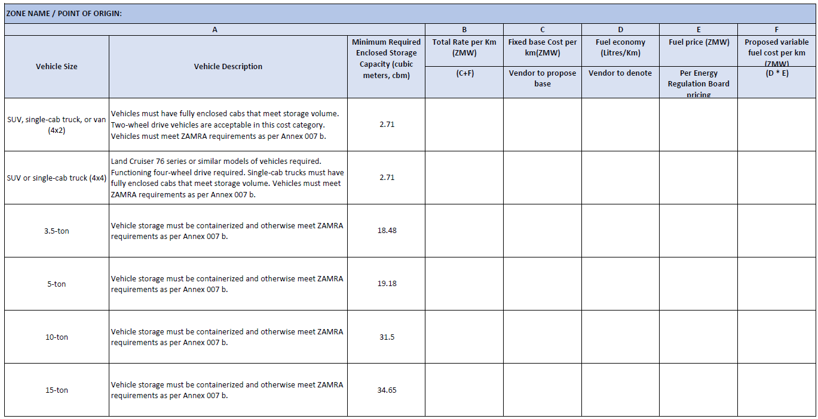
Pricing cont’d: Reference Annex 19 for details

Slide 16
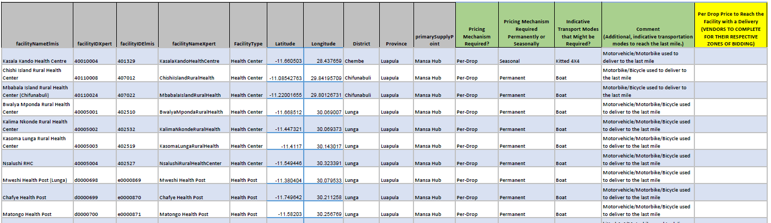
Pricing cont’d: Reference Annex 19 for details cont’d

Slide 17
Pricing cont’d: Cost Evaluation
    Using the tables above, Chemonics will calculate the average monthly cost of distribution using the Offeror’s proposed pricing, using historical average order data for the zone as per Annex 3a .

Slide 18
Annex 3 – PASCO 3PL Historical information
As the historical data is reviewed, please note that future iterations of this work as a result of this solicitation are expected to:
  Entail increased deliveries to hard-to-reach areas by 3PL in exchange for ZAMMSA increasing its servicing of the closer-to-reach facilities.
  Introduce different vehicle categories as compared to historical work, specifically segregating out two-wheel drive vs. four-wheel drive SUVs and also providing an option for a 3.5-ton vehicle.

Slide 19
Technical evaluation
Please refer to sections 1.8 and 1.9 of the RFP for the proposal validity period and technical evaluation criteria:
Each proposal will be evaluated and scored against the evaluation criteria and evaluation sub-criteria, which are stated in the table on pages 16 – 19.
Evaluation points will not be awarded for cost.
If technical scores are determined to be equal or nearly equal, cost will become the determining factor.
This RFP utilizes the tradeoff process set forth in FAR 15.101-1. Chemonics will award a subcontractor to the offeror whose proposal represents the best value to Chemonics.
Chemonics may award to a higher-priced offeror if a determination is made that the higher technical evaluation of that offeror merits the additional cost/price.

Slide 20
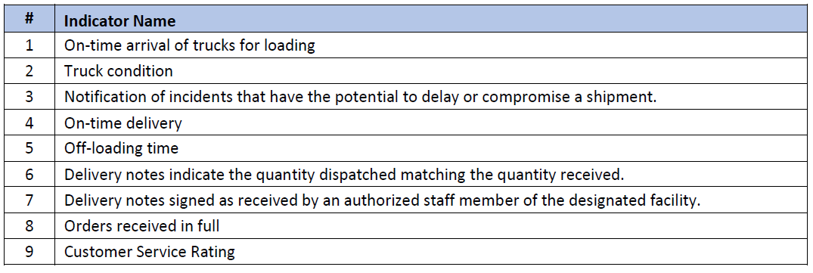
KPIs

Slide 21
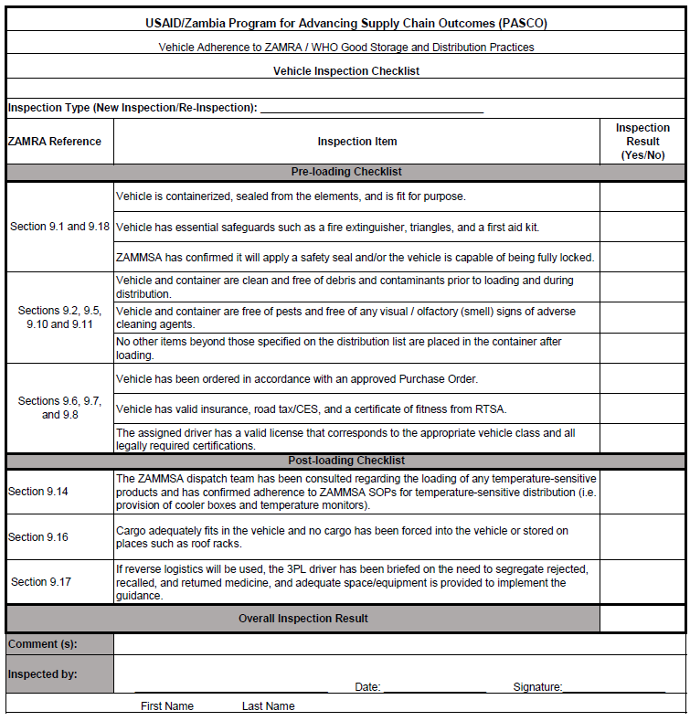
Annex 7 – Vehicle Inspection Checklist

Slide 22
Purchase Order Process Flow
ZAMMSA prepares a distribution plan 5 days in advance of raising a PO for services (Annex 13)
Chemonics prepares PO (Annex 17) that aligns with the distribution plan
Upon PO signature, 3PL Subcontractor to provide requested trucks within 48 hours, preferably 24 hours
ZAMMSA loads truck within target of 4 hours
Truck dispatch.
Delivery and receipt of countersigned POD (see page 25 in RFP).
Invoicing & Payment within 10 business days
POD transmitted by 3PL Subcontractor within 72 hours.
Chemonics and ZAMMSA inspect the vehicle before loading (Annex 7)

Slide 23
Important!
At the rates proposed, Offerors should be prepared, if awarded an IQS as a result of this solicitation, to meet the requirements of the technical scope of work at the proposed fixed rates.
This includes, but is not limited to, providing the following at the fixed rates:
  Clean, containerized, well-maintained vehicles that meet the requirements of Annex 7;
  To be positioned within 48 hours of a request for vehicles issued under an approved purchase order;
  With GPS tracking;
  With a minimum of 15% of directly-owned fleet;
  With qualified drivers that are proficient in English and can manage proof of delivery documentation;
  With a qualified logistics person based at the hub that can support logistics management.
Offerors are strongly encouraged to propose their best and most competitive prices for distribution services that meet the technical scope.

Slide 24
Instructions for the Submission of Electronic Copies
Separate technical and cost proposals must be submitted by email to the point of contact and email address by no later than the time and date specified in I.2 Offer Deadline, November 3, 2024.
The Offeror must submit the proposal electronically with up to three (3) attachments (5 MB limit per attachment) per email compatible with MS Word, MS Excel, readable format, or Adobe Portable Document (PDF) format in a Microsoft XP environment.
Offerors must submit a separate cover email without any attachments to delineate the quantity and content of emails to expect with attachments, for clarity of submission.
Offerors must not submit zipped files. Those pages requiring original signatures should be signed by using e-signatures.

Slide 25
Any Questions?

Slide 26
Thank you

