Slide 1
USAID Program for Advancing Supply Chain Outcomes
(PASCO)
3PL Factsheet
July 2023

Slide 2
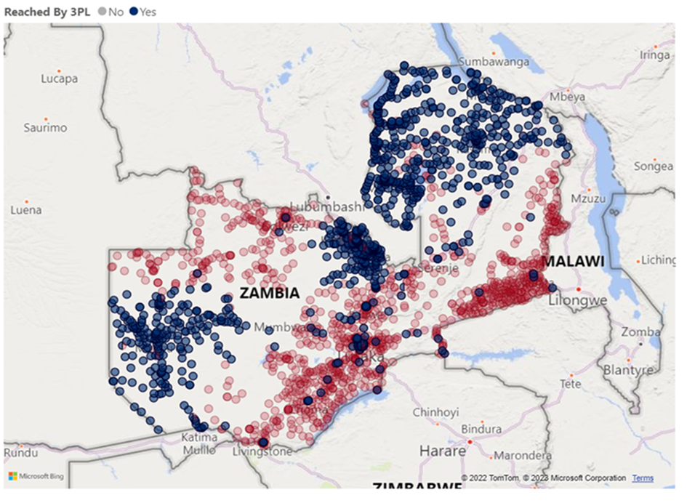
PASCO Coverage
PASCO supports ZAMMSA Hubs with last-mile operations in the Copperbelt, Luapula, Muchinga, Northern, and Western provinces.
Mansa Hub
Mpika Hub
Luanshya Hub
Mongu Hub

Slide 3
PASCO Coverage - Current Last Mile 3PL Zones
Zone # | Origin / Point of Dispatch | Destination / Recipient | Number of drop-off points (Hubs, DHOs, Health Facilities)
1 | ZAMMSA Luanshya Hub | Direct and multi-drop destinations to district health offices and health facilities in/near Copperbelt Province. | 243 destination
2 | ZAMMSA Mansa Hub | Direct and multi-drop destinations to district health offices and health facilities in/near Luapula Province. | 213 destinations
3 | ZAMMSA Mpika Hub | Direct and multi-drop destinations to district health offices and health facilities in/near Northern Province and Muchinga Province. | 89 for Muchinga and 217 for Northern
4 | ZAMMSA Mongu Hub | Direct and multi-drop destinations to district health offices and health facilities in/near Western Province. | 250 destination
A ZAMMSA dispatch officer, 3PL staff, and a security officer inspect health commodities at the ZAMMSA dispatch bay before loading onto a 3PL truck.

Slide 4
Vehicle Types by Location, Requirements, and Volume

Slide 5
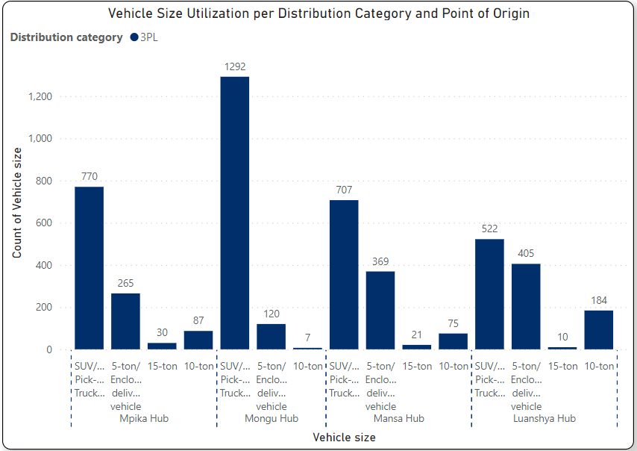
Vehicle size utilization by hub (May 2022 – Mar 2023)
Vehicle size requirements differ per province (ranging from SUVs to 15 tons) due to the variety of terrain.
Most vehicles used across the four hubs (Luanshya, Mansa, Mongu, and Mpika) were SUVs, followed by 5-ton trucks, 10-ton, 15-ton, and 15-ton trucks were the least used.
Mongu has a unique terrain, with only three vehicle types (SUVs, 5-ton, and 10-ton trucks) being commonly used.
As per WHO standards, insulated containerized vehicles must be used for the transportation of health commodities.

Slide 6
Average vehicle size utilization by hub (May 2022 – Mar 2023)
Hub Name | Vehicle Type | Average Monthly Vehicle Size Utilization | Average Weekly Vehicle Size Utilization*
Luanshya | SUV | 47 | 11
 | 5 ton | 37 | 8
 | 10 ton | 17 | 4
 | 15 ton | 1
Mpika | SUV | 70 | 16
 | 5-ton | 24 | 6
 | 10-ton | 8 | 2
 | 15-ton | 3 | 1
Mongu | SUV | 117 | 27
 | 5-ton | 11 | 3
 | 10-ton | 7
Mansa | SUV | 64 | 15
 | 5-ton | 34 | 8
 | 10-ton | 7 | 2
 | 15-ton | 2 | 1
*Depending on several factors, including the distribution loading plan, the terrain, and the season (time of the year), the same vehicle may be used multiple times to conduct last-mile deliveries.

Slide 7
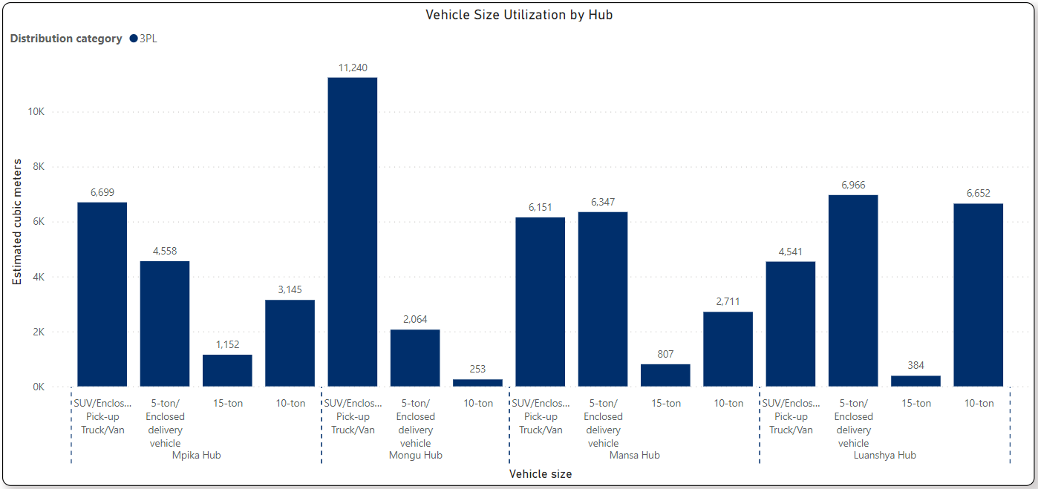
Estimated cubic meters by vehicle type and hub (May 2022 – Mar 2023)

Slide 8
Average estimated cubic meters by vehicle size and hub (May 2022 – Mar 2023)
Hub Name | Vehicle Type | Average Monthly Estimated Cubic Meters | Average Weekly Estimated Cubic Meters
Luanshya Hub | 5-ton/ Enclosed delivery vehicle | 633 | 145
 | 10-ton | 605 | 139
 | SUV/Enclosed Pick-up Truck/Van | 413 | 95
 | 15-ton | 35 | 8
Mansa Hub | 5-ton/ Enclosed delivery vehicle | 577 | 132
 | SUV/Enclosed Pick-up Truck/Van | 559 | 128
 | 10-ton | 246 | 56
 | 15-ton | 73 | 17
Mongu Hub | SUV/Enclosed Pick-up Truck/Van | 1,022 | 234
 | 5-ton/ Enclosed delivery vehicle | 188 | 43
 | 10-ton | 23 | 5
Mpika Hub | SUV/Enclosed Pick-up Truck/Van | 609 | 140
 | 5-ton/ Enclosed delivery vehicle | 414 | 95
 | 10-ton | 286 | 66
 | 15-ton | 105 | 24

Slide 9
Deliveries by type of drop and SDPs reached May 2022 – Mar 2023

Slide 10
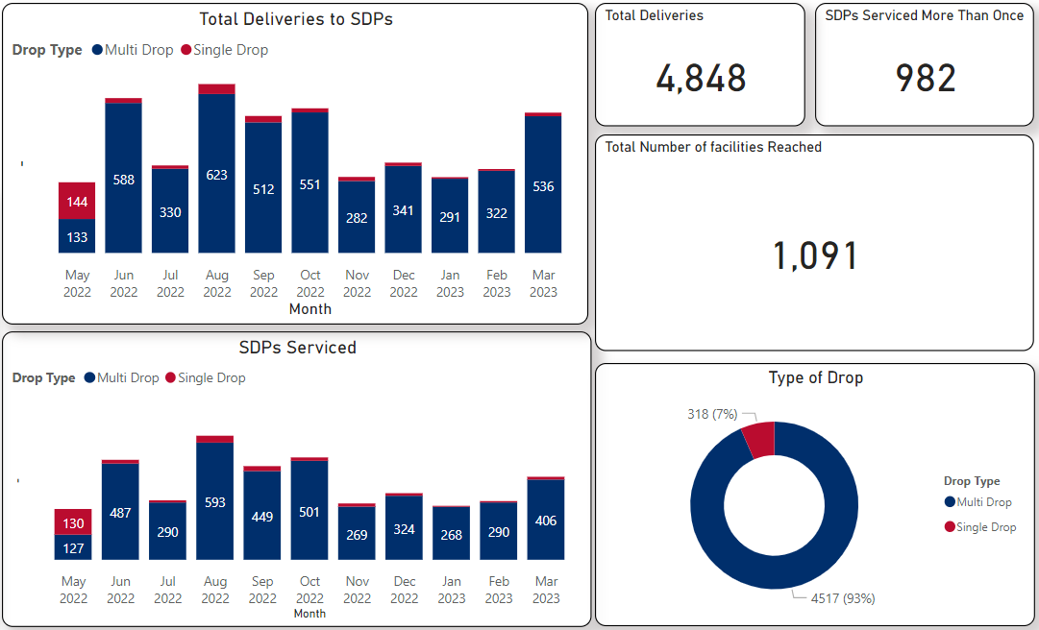
Deliveries by type of drop and SDPs reached May 2022 - 2023
4,848 total deliveries were made across the four hubs (Luanshya, Mansa, Mpika and Mongu) between May 2022 and March 2023. Of the total deliveries, the majority were multi-drop.
We observed an average of 441 delivery drops per month equating to 101 deliveries per week.
An average of 99 facilities were visited, equating to 23 SDPs per week during the reporting period.

Slide 11
Total / Average Volume May 2022 – Mar 2023

Slide 12
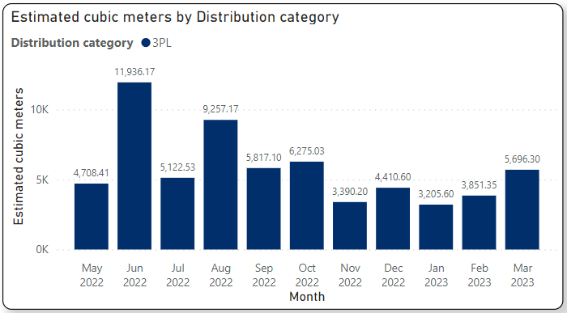
Estimated cubic meters distribution May 2022 – Mar 2023
3PL distributed 63,671 cubic meters of commodities across five hubs (Luanshya, Mansa, Mongu and Mpika) between May 2022 and March 2023.
We observed an average monthly volume of 5,788 cubic meters, which equates to 1,326 cubic meters per week.

Slide 13
Annexes by Hub
Vehicle Size, Volume, and Deliveries by Point of Origin May 2022 – Mar 2023

Slide 14
Vehicle size utilization May 2022 – Mar 2023

Slide 15
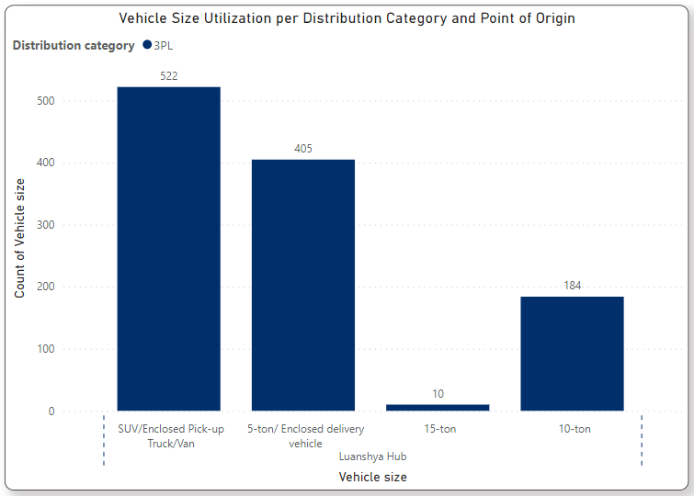
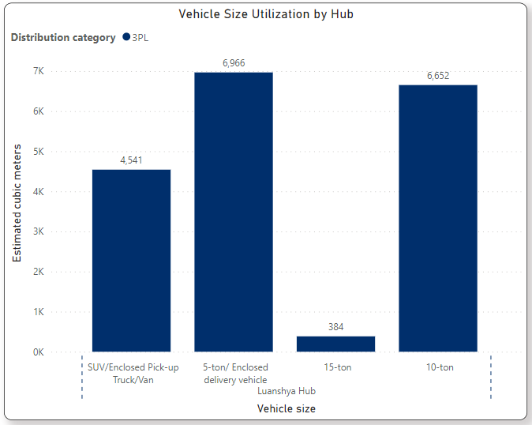
Vehicle size utilization - Luanshya
Total of 18,543 cubic meters of medical commodities were distributed between May 2022 and March 2023, with monthly average distribution by vehicle type as shown:
5-ton/ Enclosed delivery vehicle – 633 cubic meters.
10-ton – 605 cubic meters.
SUV/Enclosed Pick-up Truck/Van – 413 cubic meters.
15-ton – 35 cubic meters.

Slide 16
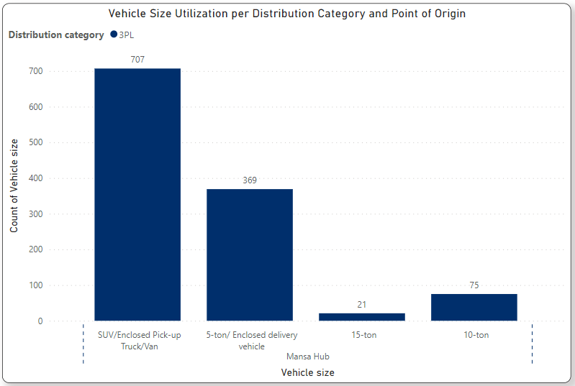
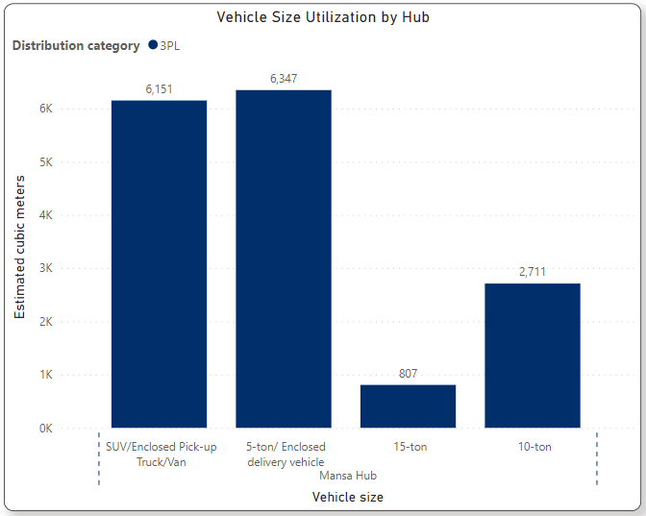
Vehicle size utilization - Mansa
Total of 16,016 cubic meters of medical commodities were distributed between May 2022 and March 2023, with monthly average distribution by vehicle type as shown:
5-ton/ Enclosed delivery vehicle - 577 cubic meters.
SUV/Enclosed Pick-up Truck/Van - 559 cubic meters.
10-ton - 246 cubic meters.
15-ton - 73 cubic meters.

Slide 17
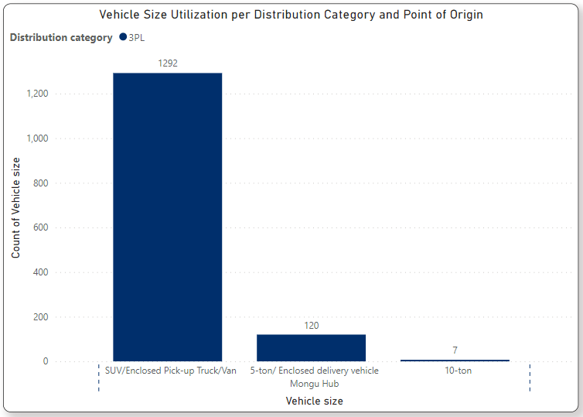
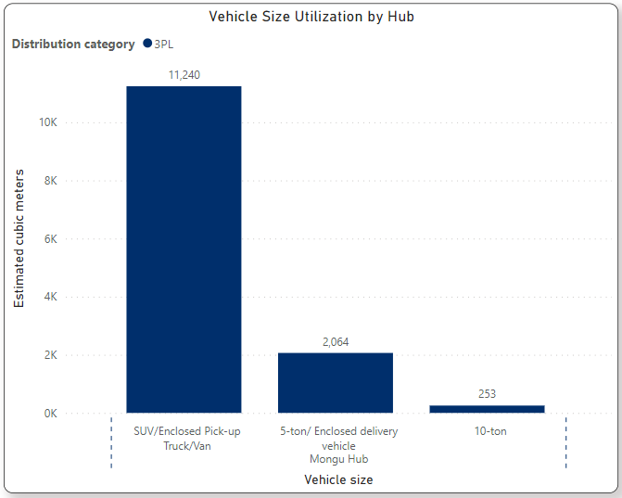
Vehicle size utilization - Mongu
Total of 13,557 cubic meters of medical commodities were distributed between May 2022 and March 2023, with monthly average distribution by vehicle type as shown:
SUV/Enclosed Pick-up Truck/Van - 1,022 cubic meters.
5-ton/ Enclosed delivery vehicle - 188 cubic meters.
10-ton - 23 cubic meters.

Slide 18
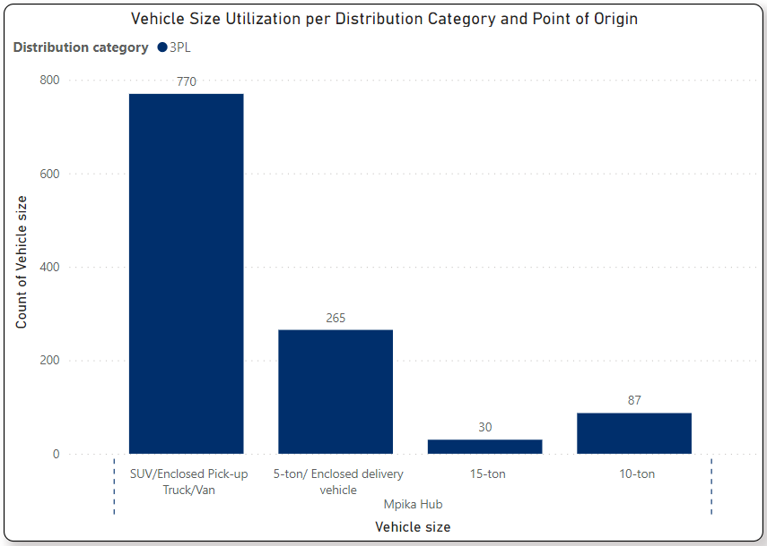
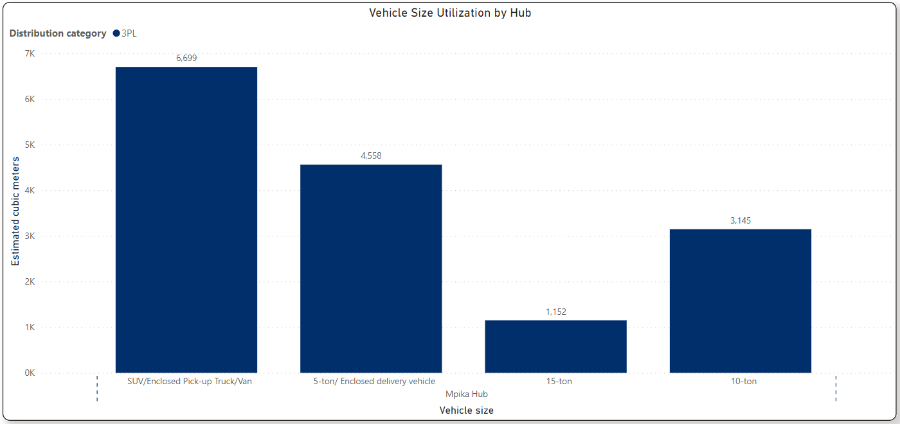
Vehicle size utilization - Mpika
Total of 15,554 cubic meters of medical commodities were distributed between May 2022 and March 2023, with monthly average distribution by vehicle type as shown:
SUV/Enclosed Pick-up Truck/Van - 609 cubic meters.
5-ton/ Enclosed delivery vehicle - 414 cubic meters.
10-ton - 286 cubic meters.
15-ton - 105 cubic meters.

Slide 19
Deliveries by type of drop and SDPs reached May 2022 – Mar 2023

Slide 20
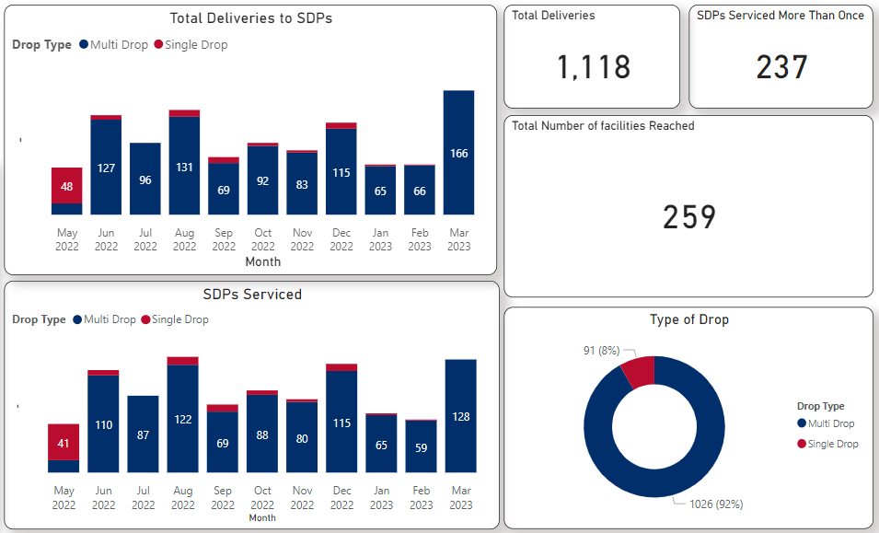
Deliveries by type of drop and SDPs reached - Luanshya
1,118 deliveries were made by Luanshya hub between May 2022 and March 2023.
We observed an average of 102 delivery drops per month.
An average of 24 facilities were visited per month, equating to 5 SDPs per week during the reporting period.
92% of deliveries were multi-drops and 8% were single drops.

Slide 21
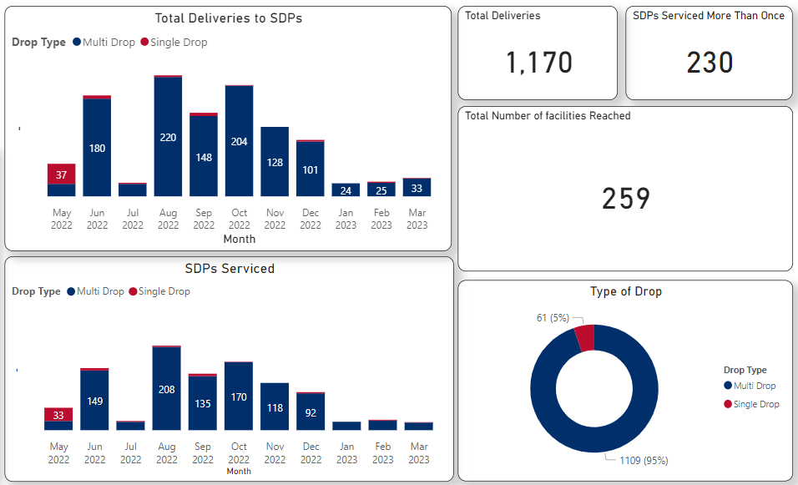
Deliveries by type of drop and SDPs reached - Mansa
1,170 deliveries were made by Mansa hub between May 2022 and March 2023.
We observed an average of 106 delivery drops per month.
An average of 24 facilities were visited per month, equating to 5 SDPs per week during the reporting period.
95% of deliveries were multi-drops and 5% were single drops.

Slide 22
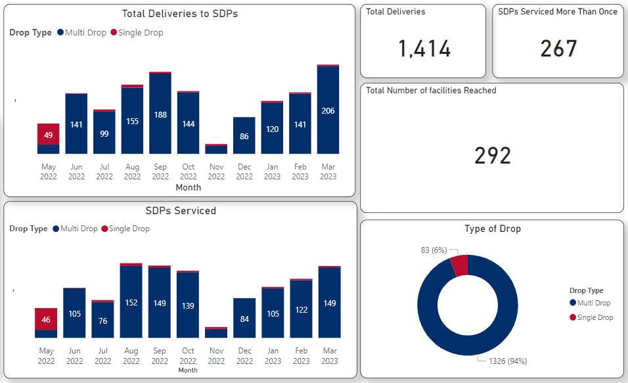
Deliveries by type of drop and SDPs reached - Mongu
1,414 deliveries were made by Mongu hub between May 2022 and March 2023.
We observed an average of 129 delivery drops per month.
An average of 27 facilities were visited per month, equating to 6 SDPs per week during the reporting period.
94% of deliveries were multi-drops and 6% were single drops.

Slide 23
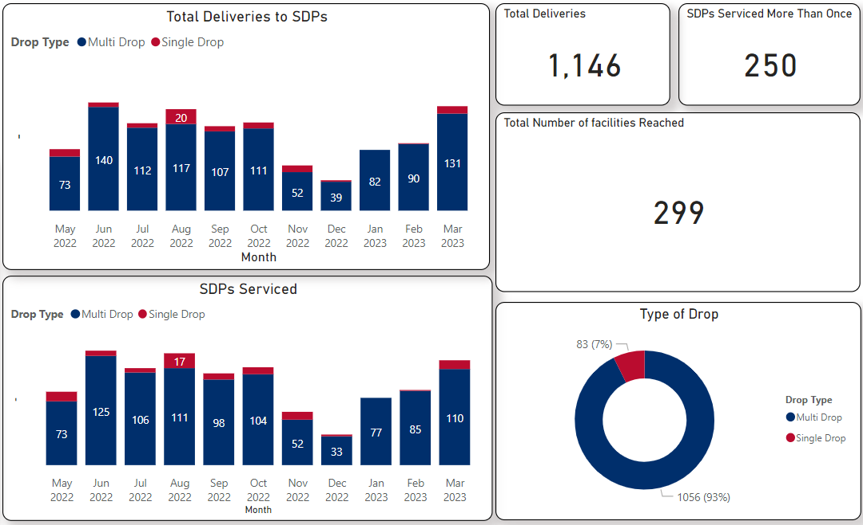
Deliveries by type of drop and SDPs reached - Mpika
1,146 total deliveries were made by Mpika hub between May 2022 and March 2023.
We observed an average of 104 delivery drops per month.
An average of 27 facilities were visited per month, equating to 6 SDPs per week during the reporting period.
93% of deliveries were multi-drops and 7% were single drops.

Slide 24
Total / Average Volume May 2022 – Mar 2023

Slide 25
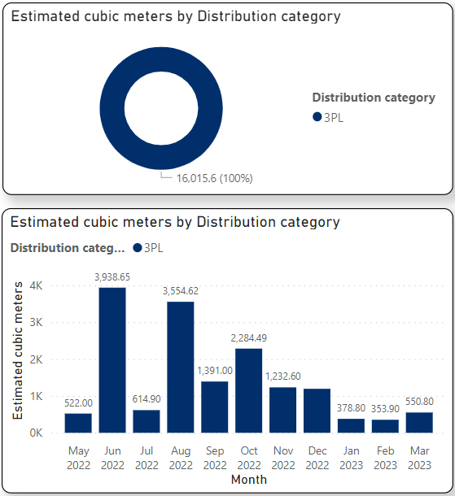
Estimated cubic meters by distribution category - Mansa
16,016 cubic meters of medical commodities were distributed from the Mansa hub between May 2022 and March 2023 representing 83% of the total volume distributed.
We observed an average of 1,456 cubic meters distributed per month and 334 per week.

Slide 26
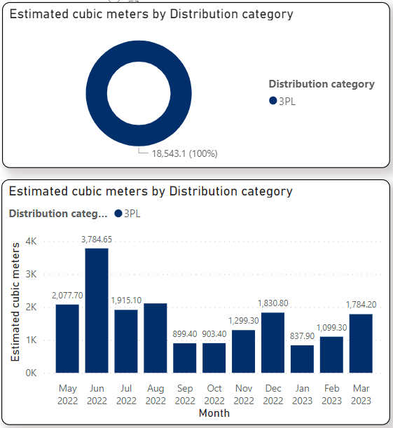
Estimated cubic meters by distribution category - Luanshya
18,543 cubic meters of medical commodities were distributed from the Luanshya hub between May 2022 and March 2023 representing 81% of the total volume distributed.
We observed an average of 1,686 cubic meters distributed per month and 386 per week.

Slide 27
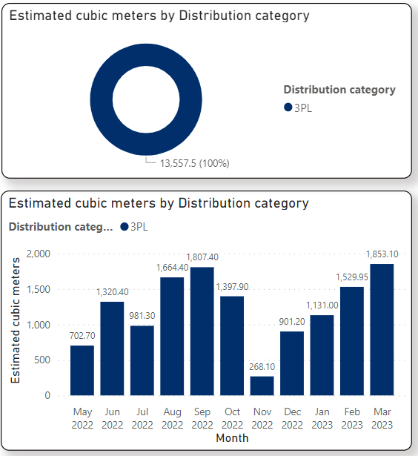
Estimated cubic meters by distribution category - Mongu
13,557 cubic meters of medical commodities were distributed from the Mongu hub between May 2022 and March 2023 representing 81% of the total volume distributed.
We observed an average of 1,232 cubic meters distributed per month and 282 per week.

Slide 28
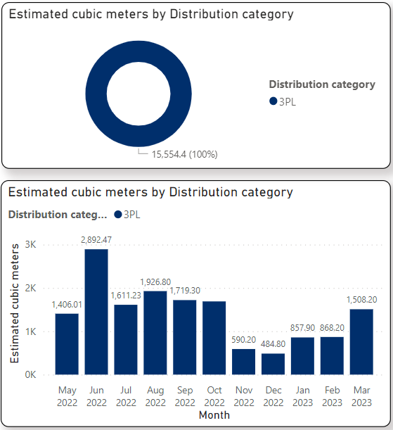
Estimated cubic meters by distribution category - Mpika
15,554 cubic meters of medical commodities were distributed from the Mpika hub between May 2022 and March 2023 representing 70% of the total volume distributed.
We observed an average of 1,414 cubic meters distributed per month and 324 per week.

Slide 29
Total (One Way) / Average KM Covered May 2022 – Mar 2023

Slide 30
Kilometers covered by distribution category - Luanshya
3PL vehicles covered 50,934 kilometers from the Luanshya hub to distribute health commodities between May 2022 and March 2023.
Translating into an average of 4,630 kilometers per month and 1,061 per week.

Slide 31
Kilometers covered by distribution category - Mansa
3PL vehicles covered 88,296 kilometers from Mansa hub to distribute health commodities between May 2022 and March 2023.
Translating into an average of 8,027 kilometers per month and 1,840 per week.

Slide 32
Kilometers covered by distribution category - Mongu
3PL vehicles covered 185,704 kilometers from Mongu hub to distribute health commodities between May 2022 and March 2023.
Translating into an average of 16,882 kilometers per month and 3,869 per week.

Slide 33
Kilometers covered by distribution category - Mpika
3PL vehicles covered 292,407 kilometers from Mpika hub to distribute health commodities between May 2022 and March 2023.
Translating into an average of 26,582 kilometers per month and 6,091 per week.

